Slide 1
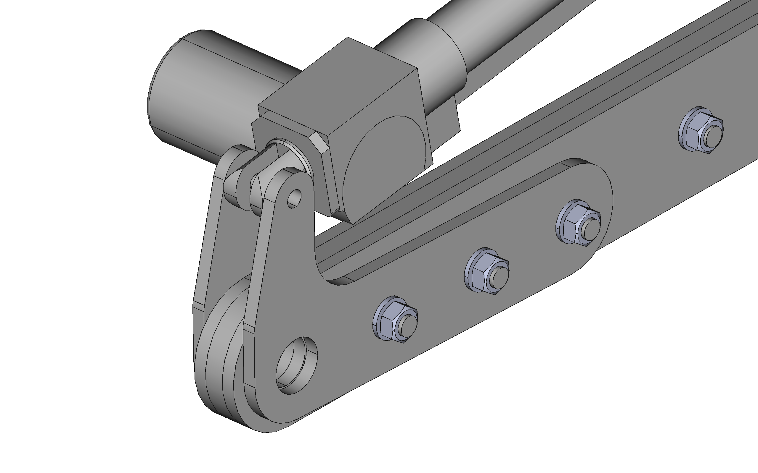
Add shims until actuator bracket is not trapped between mounting plates

Slide 2
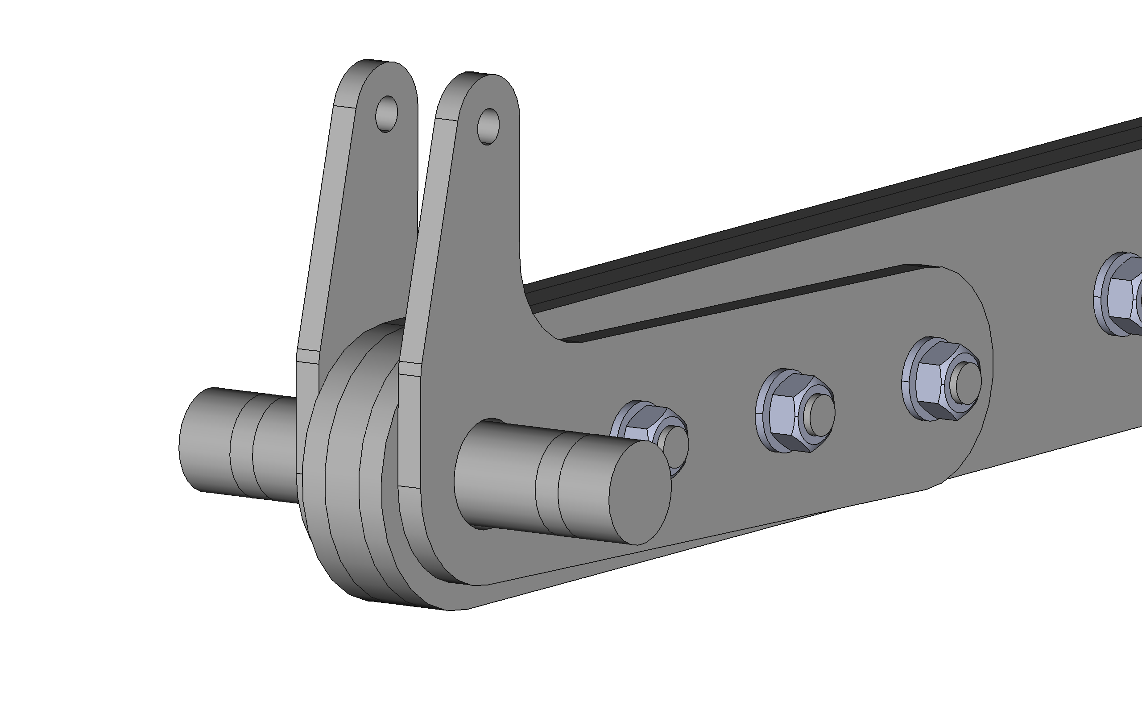
Check the actuator mounting bracket angles are identical using an engineer’s square
Use 30mm pin plus shims/tape to help align ends of actuator mounting brackets
Pivot holes and end bracket holes should be positioned concentric for correct bracket angle

Slide 3
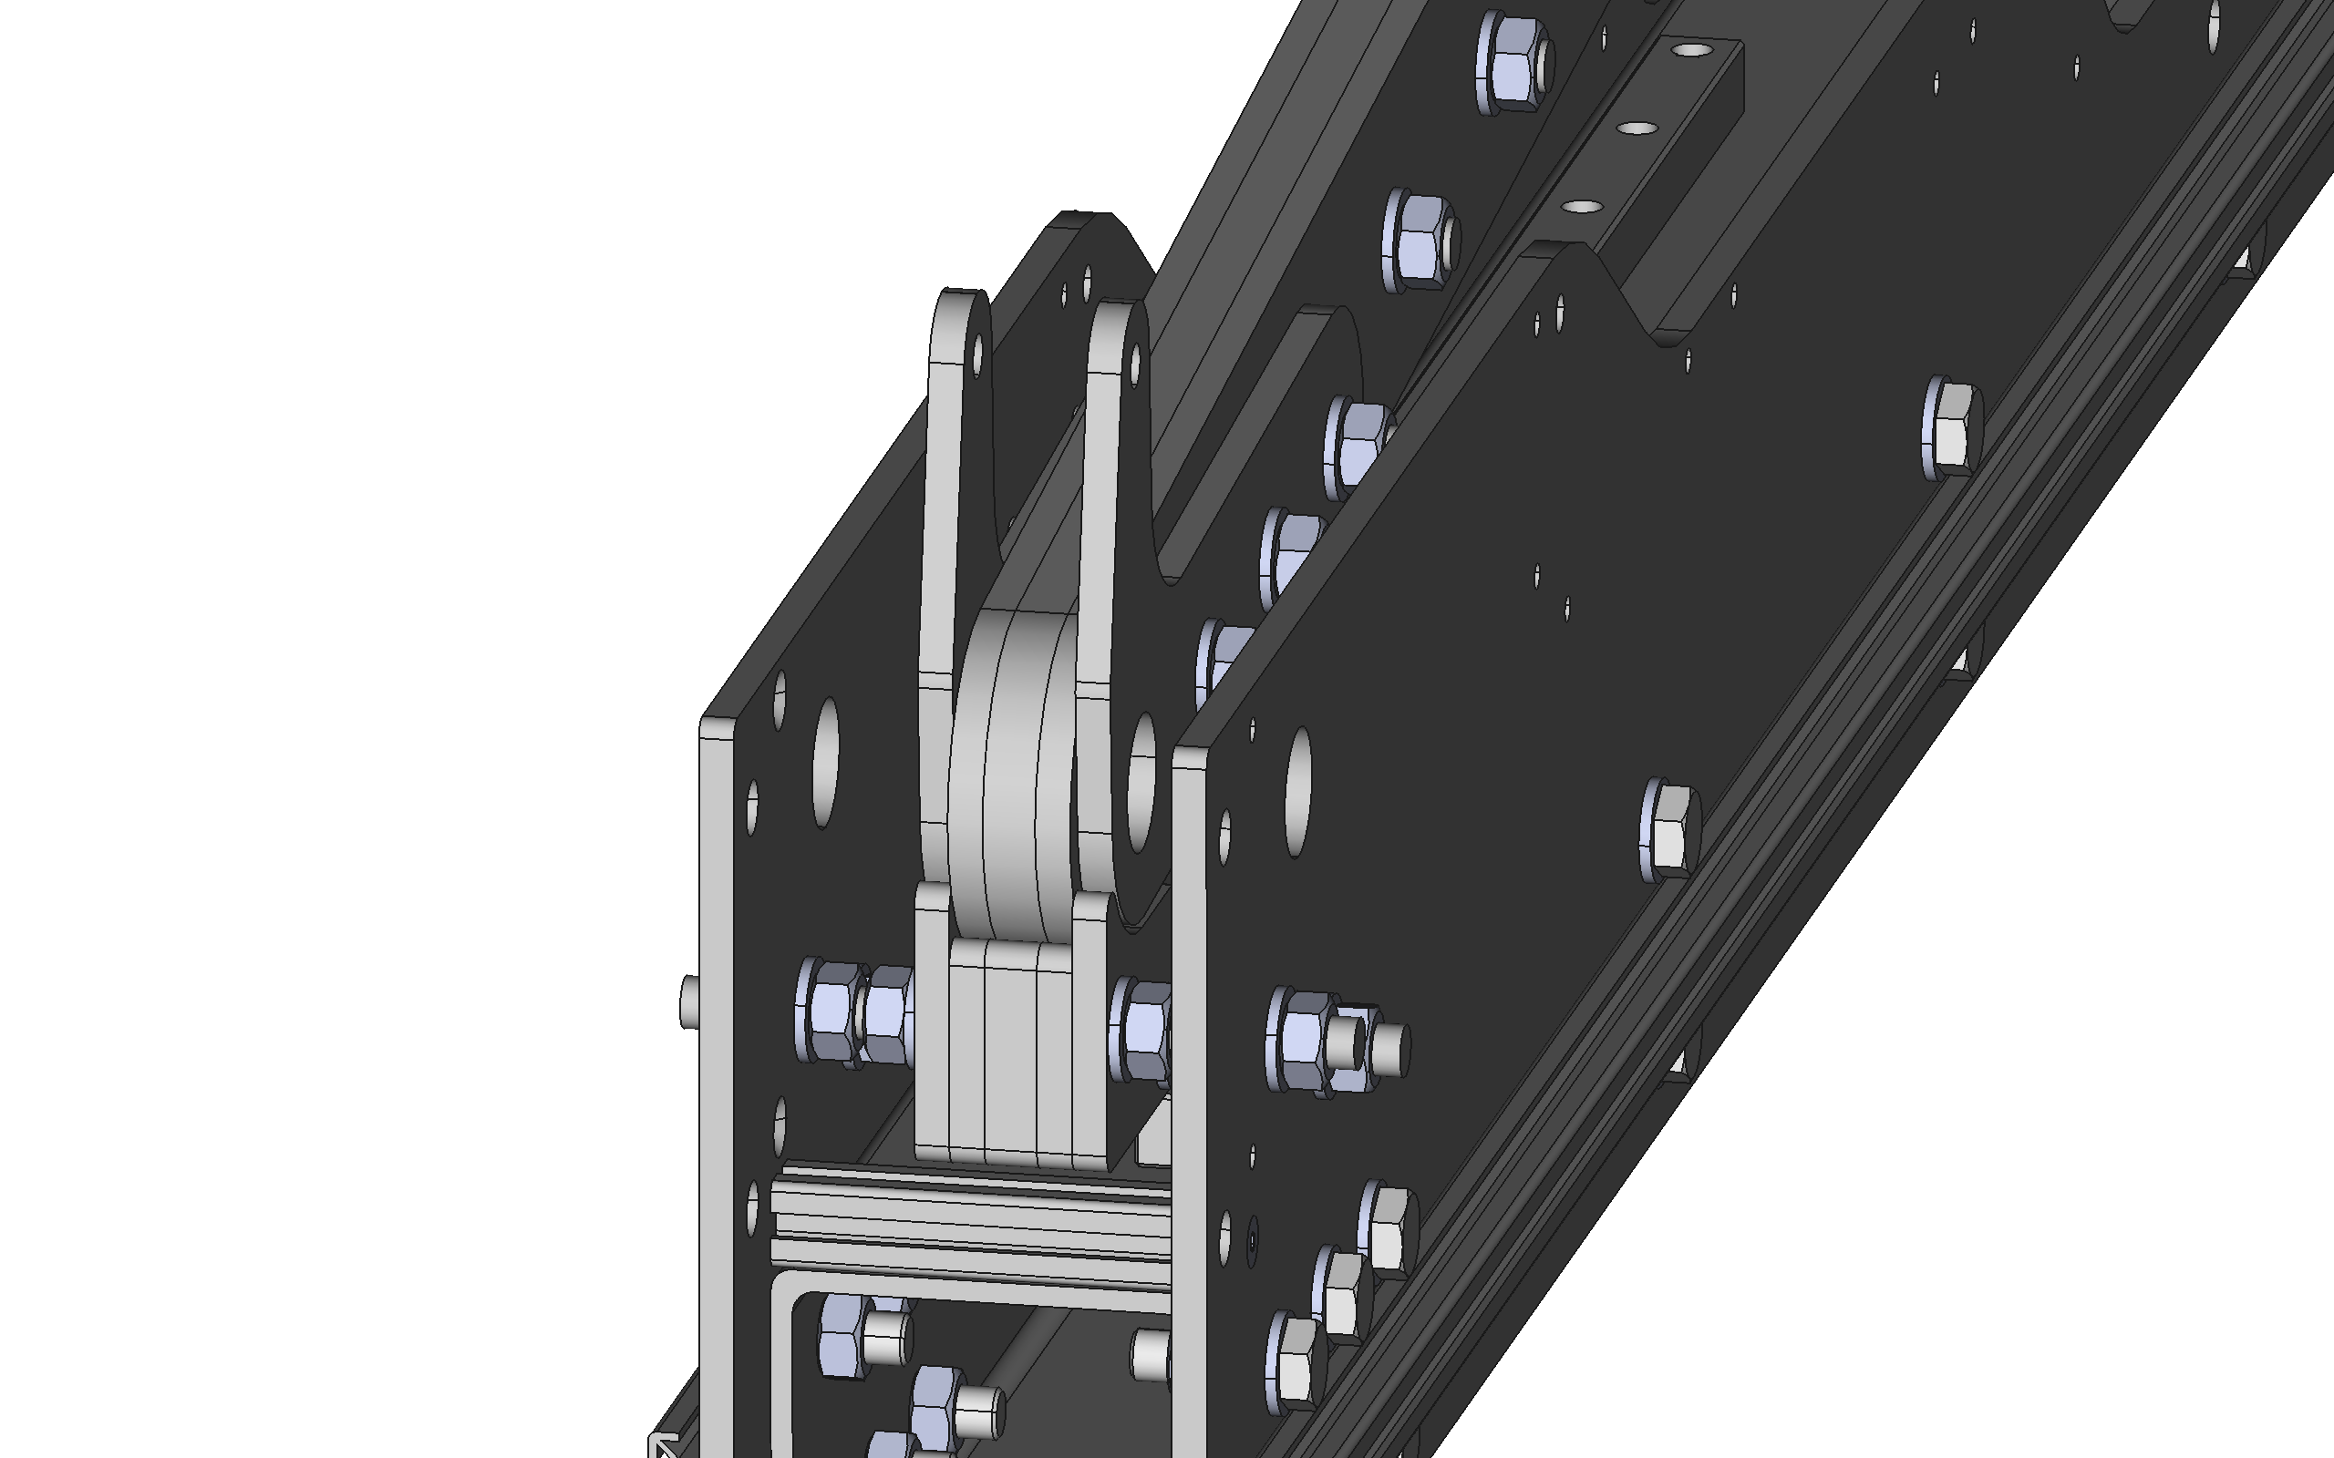
Add shims (if required) between the pivot lateral guide plates such that the pivot arm is not being trapped

Slide 4
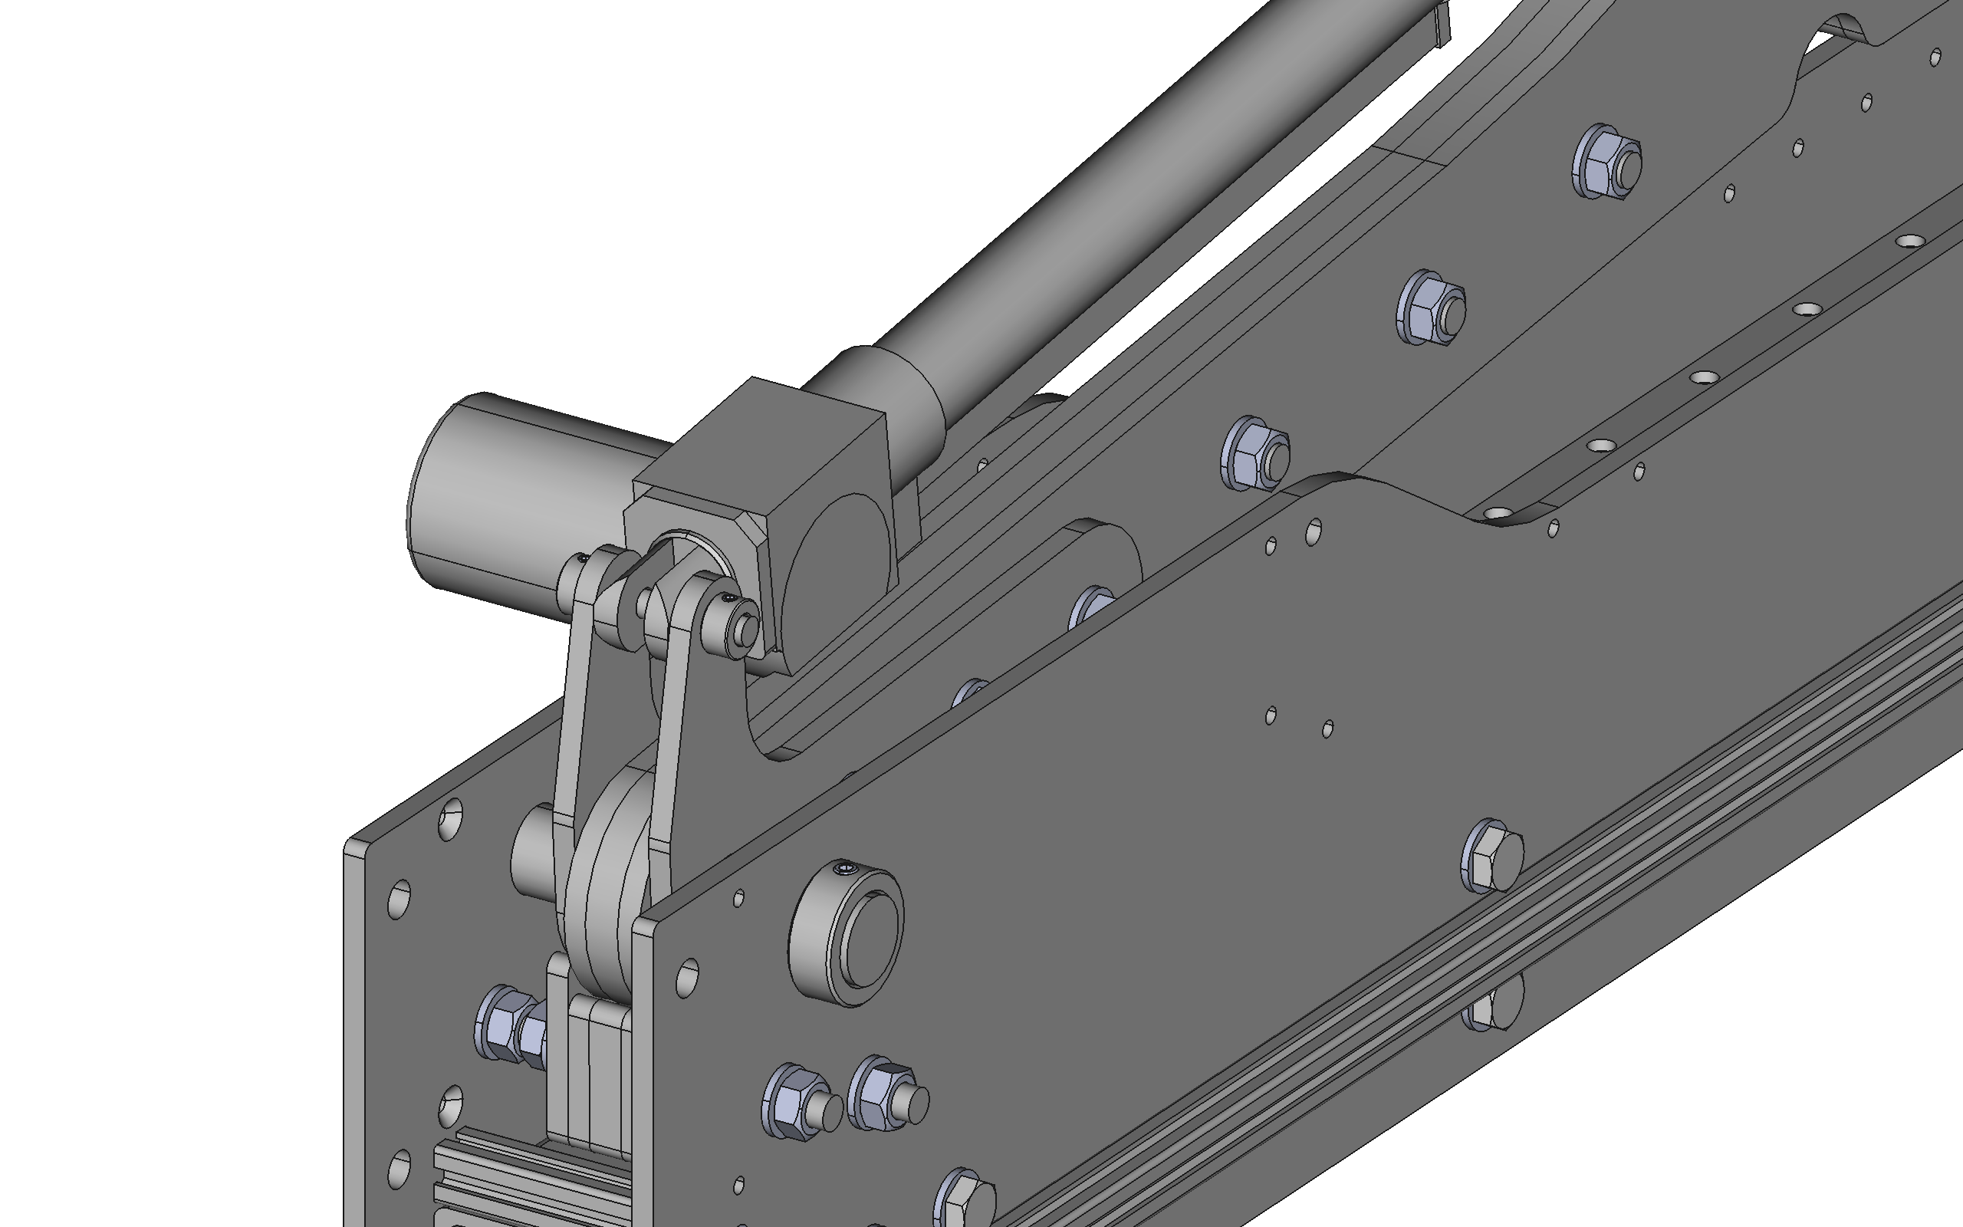
Fit pivot arm assembly to instrument frame and actuator body to pivot arm with steel pins and shaft collars

